Slide 1

Image color processing and future progress
2020/10/13 Second group meeting

Slide 2


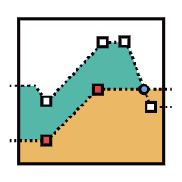
Check list
CONTENTS
What do we have so far?
What to discuss today?

Slide 3

1. Checklist
Research
Readings
Github Sub-branch?
Merge code in colab?
Nate
Gloria
June
Ming
Hans

Slide 4


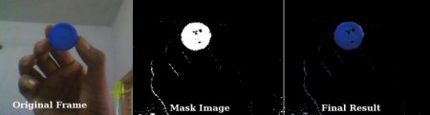

2. What do we have so far?
Data pre-processing
Process of extracting certain type of color from our data
We have successfully flipped the image so right side and left side is facing the same direction. Also converted to Gray Scale and HSV. General methods we are going to use after color processing. (embedding process, matrix -> array with value of 0 and 1). Usage of SVM to detect the spot, also second SVM to detect spots like acnes, moles.
As all of our team members know, information and process we have so far are all in the google doc. Documents that could be a good resource for us is in the GitHub. We can think about our embedding process of transform and extract meaningful value in stock in the matrices and transform once more in to the array. Those websites below can help us understand the logic behind our color processing, some even provides general example codes and pictures of extracting certain features.
Things to think about
Helpful website: https://docs.opencv.org/3.4/de/d25/imgproc_color_conversions.html
https://machinelearningmastery.com/how-to-perform-face-detection-with-classical-and-deep-learning-methods-in-python-with-keras/
https://docs.opencv.org/master/df/d9d/tutorial_py_colorspaces.html

Slide 5
3. To discuss
Like I mentioned in the previous slide, we need to discuss what is next. Our meeting with mentor is tomorrow, and I’m pretty sure he can give us more guidance on what to do next. Meanwhile, we can talk about what we have so far, and focus on the research that might be helpful to our proejct. Also, we have weekly meeting with our advisor every Monday, and I’m going to prepare ppt for our advisor beforehand, so we have to discuss how we going to wrap up our progress each week.

